Slide 1
Data Modeling with Graph Databases
Ross McNeely
Principal Consultant, Practice Manager, Business Intelligence
“Data Junkie”

Slide 2
Data Modeling with Graph Databases
CREATE TABLE #Info
(Info_Type VARCHAR(25)
,Info_Value VARCHAR(50))
INSERT INTO #Information VALUES
('Name','Ross McNeely')
,('Email','rmcneely@tailwindbi.com')
,('Company','Tail Wind Informatics')
,('CompanySite','www.tailwindtech.com')
,('LinkedIn','www.linkedin.com/in/rossmcneely')
,('Blog','www.mcneelydwbi.wordpress.com');
SELECT Info_Type, Info_Value FROM #Information

Slide 3

Speaker Bio
Ross McNeely is the Principle Consultant & BI Practice Manager at Tail Wind Informatics.
Ross has been working with MS SQL Server BI stack for over a decade.
Enterprise Information Management & Business Intelligence are Ross’ primary focus.

Slide 4
http://tailwindtech.com
Business Intelligence Solutions
“Go Farther, Faster”

Slide 5
Data Modeling with Graph Databases
Agenda
Introduction to the Graph Model (15 min)
Data Modeling with Graph Databases (15 min)
Relational and Graph Models (10 min)
Healthcare Use Case (20 min)
Deeper Dive into Graph Databases (20 min)
Logistics Use Case (15 min)
Security Use Case (15 min)
Summary (5 min)

Slide 6
Data Modeling with Graph Databases
Introduction to the Graph Model
Defining the Graph Database
Overview of the Graph Market
Benefits of the Graph Data Model
Notes:
Some of the techniques I have used and others I have not. I will do my best to point out the techniques I have not used, and provide references.

Slide 7
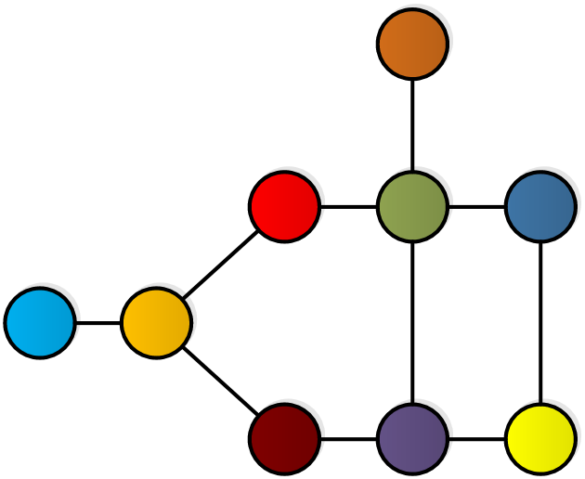
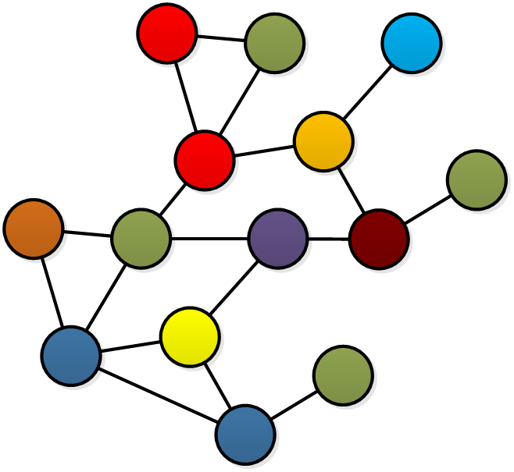
Defining the graph database
Introduction to the Graph Model

Slide 8
Notes:
There are a few flavors of Graph Databases. Triplestores (Resource Description Framework RDF), and Hypergraphs. Today I will be talking primarily about the Property Graph Database, but will refer to it as Graph.
Mentally I think of the graph in terms of circles. There are examples out there where you see squares connected instead of circles.

Slide 9
Introduction to the graph Model
Graph Defined:
¹“Formally, a graph is just a collection of vertices and edges-or, in less intimidating language, a set of nodes and the relationships that connect them.”
Less Formally Defined:
-A graph is a set of nodes, relationships, and properties.
-A network of connected objects.
Notes:
Graph modeling matches how we abstract out domain knowledge. “Whiteboard friendly”
Graph modeling is great at showing how things are related but also the question we want to ask.
The graph database takes a very different approach to “connections” relationships. The approach is focused on the richer, expressive relationships between nodes. A relationship is just as important as the node.

Slide 10
Introduction to the graph model
Property Graph
Nodes (“vertices”)
Relationships (“edges”)
Properties
Notes:
1“A property graph is made up of nodes, relationships, and properties.
• Nodes contain properties. Think of nodes as documents that store properties in the
form of arbitrary key-value pairs. The keys are strings and the values are arbitrary
data types.
• Relationships connect and structure nodes. A relationship always has a direction,
a label, and a start node and an end node—there are no dangling relationships.
Together, a relationship’s direction and label add semantic clarity to the structuring
of nodes.
• Like nodes, relationships can also have properties. The ability to add properties to
relationships is particularly useful for providing additional metadata for graph”

Slide 11
Introduction to the Graph Model
Nodes
Nodes represent entities
Nodes contain properties. Think of nodes as documents that store properties in the form of arbitrary key-value pairs.

Slide 12
Introduction to the Graph Model
Relationships
Relationships are the lines between nodes.
Relationships connect and structure nodes.
Notes:
Graph Databases are highly connected data model. Relationships are cheap.
A relationship must have a start node and an end node. No more, no less.
Relationships can come and go as the domain is built out.
Relationships for the business domain.
Relationships for the different queries.
In a way you could think of it as a cube with each level of the cube containing different relationships. (Don’t actually build that much complexity)
A relationship is a first class citizan

Slide 13
Introduction to the Graph Model
Properties
Properties are values about the node or relationship.
Properties can be added to nodes and relationships.
Allows you to create additional semantics to relationships.
Notes:
Each properties is a key/value
Everybody gets a property (Nodes/Relationships) Not get but can.

Slide 14
Introduction to the graph model
Basic Graph

Slide 15
Overview of the graph market
Introduction to the Graph Model

Slide 16
Introduction to the Graph Model
ArangoDB
BigData
Bitsy
BrightStartDB
DEX/Sparksee
Filament
GraphBase
Horton
HyperGraphDB
OpenLink
R2DF
Titan
VelocityGraph
VertexDB
Notes:
There are a lot of graph db on the market.
Native graph storage and native graph processing are neither good nor bad. But simply a trade-off. The benefit of native graph storage is that is purpose-built for performance and scalability. Native graph process benefits traversal performance, but at the expense of making some nontraversal queries difficult

Slide 17


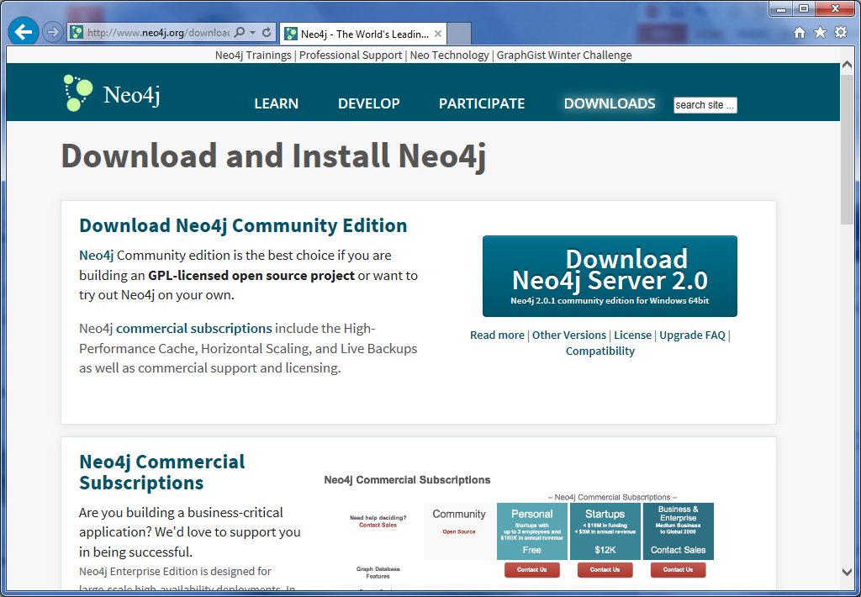
Introduction to the graph model
Property Graph
Triples*
Hypergraph
Neo4j
Allegro Graph
Hyper Graph DB
*Triple Stores come from the Semantic Web movement. A triple is a subject-predicate-object data structure
Notes:
In my research of the Hypergraph is was thrown back by some of the perceived “increased complexity” over a property graph. That perceived “increased complexity” is now seen a possible “increased flexibility” referring to relationships into nodes. Granted the increased flexibility for the modelers is an increase in complexity to the business users. A logical model would be helpful if I deployed a hypergraph.

Slide 18
Benefits of the graph model
Introduction to the Graph Model

Slide 19
Data Modeling with Graph Databases
What does the graph database offer?
It is an agile modeling approach
No pre-defined schema
General purpose graph data schema
Easy of use with the Business
Notes:
My requirements where fluid.
No time to formally gather all requirements.
Multi-phases.
No Pre-defined schema means you could create a single node and put everything as a property.
It is NoSQL, but…
This is not the NoSQL approach.
I don’t always use NoSQL, but when I do I always use a SQL query.
Think of it as a general purpose data structure.

Slide 20
Data Modeling with Graph Databases
Performance
Performance increase when dealing with connected data.
Flexibility
We can add nodes/relationships as the business domain dictates.
Agility
Agile and test-driven software development practices.
Notes:
Performance better when multiple joins
Performance Queries are localized within the graph
There are flexibility issues regarding the transition of relationships into nodes
Flexibility could be better in hypergraphs.
Agility can leverage the schema and subgraph capabilities, and the API/Query allows for testability.

Slide 21
Data Modeling with Graph Databases
Data Modeling with Graph Databases
Why Data Model with a Graph Database?
Graph Modeling

Slide 22
Why data model with a graph database
Data modeling with graph databases

Slide 23
Data modeling with graph databases
Q: Why did I want to use a graph database?
Requirement #1: It is all about the relationships.
Requirement #2: First learn requirement #1.
A: Here is the simplified version of my requirements.
Notes:
My requirement was to find matches. (Relationships)
I had people telling me that we would have implemented a NoSQL solution. My first question was what is the benefit. Answer, there is no schema… we can just load the data. Ok. First hurdle is over. Then what? Then we define the schema. (At some point we have to do work)
I did not have to worry about the app development. I did however try to be a good data steward.

Slide 24
Introduction to the graph model
Graph Structure

Slide 25
Graph modeling
Data modeling with graph databases

Slide 26
Data Modeling with Graph Databases
The Modeling Half
The Database Half
Notes:
I’m still thinking CRUD
I’m actually thinking that NORMA is the perfect modeling tool for graph databases.
It has been 2 years since my last NORMA model, but the entire time I was working with the graph I was thinking interms of the NORMA data modeling techniques.

Slide 27
Data Modeling with Graph Databases
Graph Database:
¹“A graph database management system (G-DBMS) is an online database management system with Create, Read, Update, and Delete (CRUD) methods that expose a graph data model.”

Slide 28
Data Modeling with Graph Databases
Graph Modeling Rules: “By the book¹”
Nodes for Things, Relationships for Structure
Use nodes to represent entities –this is things that of interest
Use relationships to (build structure)
Use node properties to represent entity attributes, plus metadata
Express connections between entities
Establish semantic context for each entity
Use relationship properties to express the strength, weight, or quality of a relationship, plus metadata.
Notes:
First gold star. If you wanted to print some slide, then I identified the 4 slides you will most likely want.
1st star is the Rules

Slide 29
Introduction to the graph model
How do you use a graph database?
Traversal of the database.
Query
Follow the relationships from node to node
Result Options
A set
A path
A pattern
Notes:
“Walk on the path” sign, or walk on the stepping stones.
“Walk through the network”
Traversal
Any familiar with the hierarchical data type? Very similar.
Accidentally created a graph database with the hierarchical data type.
A pattern of nodes/relationships… Think clickstream analysis or Action/Result

Slide 30
Introduction to the graph model
Set
Path
Pattern
Notes:
Each result can be a node/relationship
Set: Query just the green
Path: Query starting at purple find the path to Orange
Pattern: Query green-blue combo.

Slide 31
Data Modeling with Graph Databases
Relational and Graph Models
The Similarities
The Differences

Slide 32
Relational and graph models
Similarities
Define and agree upon the domain entities
Define the interactions, and governing rules
Whiteboard stage is the same
Differences
Few changes from conceptual to logical to physical
Graphs storage model matches the logical model
After the initial domain definition we enhance the graph instead of defining the tables.

Slide 33
Relational and graph models
Relational
Graph
Notes:
Adjacency: every node has a direct pointer to its adjacent elements and no index lookups are necessary.

Slide 34
Data Modeling with Graph Databases
Healthcare Use Case
Patient Matching

Slide 35
Healthcare use case
Accountable Care Organizations (ACOs)
Patient Protection and Affordable Care Act of 2010
Transform health providers into ACOs
What does this boil down to?
Patient Matching

Slide 36
Healthcare use case
Patient Matching
⁶Two specific objectives
Identify common attributes
Define processes and best practices
Scope of Problem
⁶Up to 14% percent of medical records contain erroneous data
Notes:
Identify common attributes that achieve high positive match rates across disparate systems. The attributes may include common fields such as name, date of birth, address, sex, cell, emergency contact, insurer, etc…
Define processing and best practices that are the most effective to support high positive patient matching rates utilizing these attributes.
HIMSS also issued a 2009 white paper titled: Patient Identity Integrity; A White Paper by the HIMSS Patient Identity Integrity Work Group. Between 8 and 14 percent of electronic health records have patient identity errors, according to a 2008 RAND Corporation study of the issue. These errors are a major patient safety issue and cost driver. Misidentifying patients, incomplete records, multiple records for the same patient, more than one patients’ information in the same record, false negative and false positive identifications are safety and quality of care issues and totally unacceptable. Additionally, healthcare organizations, payers, and the government spend millions of dollars annually correcting these errors.
DQS, MDS solutions

Slide 37
Healthcare use case
Master Data Lookup
FirstName
LastName
DOB
Gender
SSN
Address1
Notes:
DQS (Correct, Corrected, Suggested, New, Invalid) in-graph indices
MDM lookup (Match, No Match, Overmatch)

Slide 38
Healthcare use case
Normalization
Notes:
Keep in mind that I have to be able to send back the original information to the originator.

Slide 39
Healthcare use case
I created a matching site based on social graph database example
Notes:
The node are created alphabetically. Which means I created a standard naming conventions. (At least internally)
Linkedin Social Graph + Match.com Dating Graph = Patient Identity Graph

Slide 40
Data Modeling with Graph Databases
Deeper Dive into Graph Databases
Graph Modeling Continued
Graph Modeling Mistakes
Patterns
Misc.

Slide 41
Graph modeling continued
Deeper dive into graph databases

Slide 42
DEEPER Dive into graph databases
Graph Modeling Guidelines:
The query patterns drive the data model
Normalization is a natural trend in graph modeling
In general normalization has a low cost
Complexity with normalization will drive traversal speeds up
The SIP Methodology²
Use in-graph indices for range queries*
Node and Relationship Redundancy is not bad.
Schema development over time
Database extensions*
*Have not used myself
Notes:
1st Rules, 2nd Guidelines
I searched for Graph Modeling Rules. I found zero. No big deal after all it’s fairly new. Then I found “The Rule” during my research. “The Rule” almost made me drop any consideration I had for implementing a graph database. I will show you what I consider the primary rule, and then I will tell you what “The Rule” is. As Graph Modeling matures I’m sure they will remove “The Rule” in future documentation.
Don’t go overboard with redundancy. If you find that you are apply redundancy to solve the majority of design issues then I would re-evaluate.
In-graph indices: In stead of creating a property on a node… That property would become a node, and create relationships
Looking through these rules you will see that it is not for lists.
Database extensions: New logic over old portion of the schema.

Slide 43
DEEPER Dive into graph databases
Graph Modeling Dilemmas:
Q: Should I create a Relationship or a Property?
Q: Should every node with the same key/value (property) be connected?
A: It depends.
Notes:
1st Rules, 2nd Guidelines, 3rd Gotchas
If you need to connect something modeled as a relationship to more than two other entities, then you have to refactor the entity inside the relationship out into a separate node. This a break change to the data model. Changes to queries and applications will be needed.1

Slide 44
Graph modeling mistakes
DEEPER Dive into graph databases

Slide 45
DEEPER Dive into graph databases
What was I thinking?
CHAOS
  I started without a plan
Notes:
Dogs and cats living together… mass hysteria

Slide 46
DEEPER Dive into graph databases
This is easy!
DESIGN PATTERNS³
  Linked List
  Multiple Relationships
  Tags and Categories
  Multi Level Tree
  R-Tree (spatial)
  Activity Stream
  Anti-pattern: Unconnected graph
Notes:
1st Rules, 2nd Guidelines, 3rd Gotchas, 4th Patterns
This is so easy! (My seamless moment)

Slide 47
patterns
DEEPER Dive into graph databases

Slide 48
DEEPER Dive into graph databases
Anti-pattern
Pattern: Linked List
Notes:
Is there a pattern of lists that results in more medals?

Slide 49
DEEPER Dive into graph databases
Anti-pattern
Pattern: Multiple Relationships

Slide 50
DEEPER Dive into graph databases
Anti-pattern
Pattern: Tags and Categories¹

Slide 51
DEEPER Dive into graph databases
Pattern: Multi-Level Tree¹
Notes:
You will remove large portions of the graph by following a single relationship path.
You can also take advantage of the cache and hold section of the tree in memory.

Slide 52
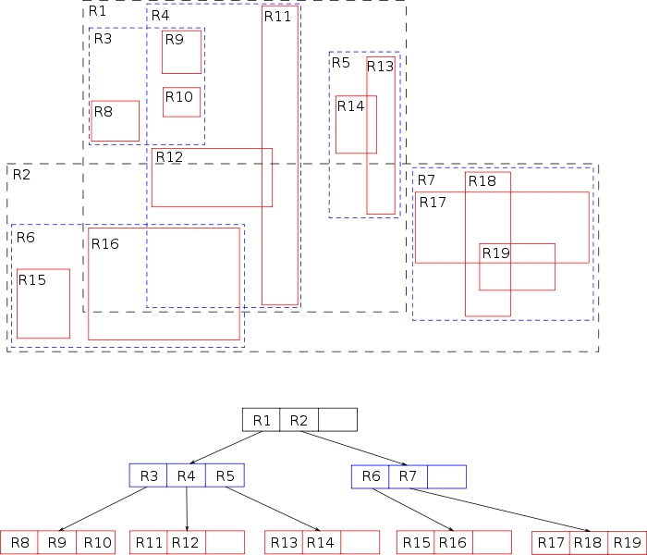

Data Modeling with Graph Databases
Notes:
You will remove large portions of the graph by following a single relationship path.
You can also take advantage of the cache and hold section of the tree in memory.

Slide 53
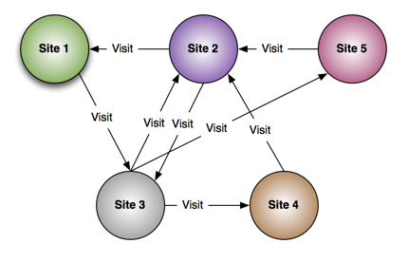
DEEPER Dive into graph databases
Pattern: Stream Analysis⁵
http://blog.bruggen.com/2013/11/clickstreams-are-so-much-nicer-in-neo4j.html

Slide 54
miscellaneous
Deeper dive into graph databases

Slide 55
Deeper dive into graph databases
Fine-Grained Relationships
Generic Relationships
Notes:
Trade-offs between using fine-grained relationship lables versus generic relationships qualified with properties. DELIVERY_ADDRESS, HOME_ADDRESS, etc. versus ADDRESS [type: ‘delivery’,’home’]1

Slide 56
Deeper dive into graph databases
OLTP
Graph Databases
Native Graph Storage
OLAP
Graph Compute Engines
Index-free adjacency processing
Identify clusters in data
Optimized for scanning and processing large sets

Slide 57
Deep dive into graph databases
Enterprise Ready
Monitoring
Live backups
High performance caches,
HA clustering

Slide 58
Deeper dive into graph databases
Physical Model
Joins have a low cost
Index-free “adjacency of entities”
Performance is in related to the result size
CONS
Tabular Data Items
Blobs
Notes:
Performance is in relationship to the result size, and not the as dependent on the database size.
Adjacency: every node has a direct pointer to its adjacent elements and no index lookups are necessary.

Slide 59
Common Use Cases
Social
Recommendations
Geo
Master Data Management
Network & Data Center Mgmt
Authorization and Access Control

Slide 60
Data Modeling with Graph Databases
Logistic Use Case
Multiple Picks
Multiple Drops

Slide 61
Logistics use case
Multiple Picks/Drops
Carries need to optimize
Make multiple pickups
Make multiple drop-offs
Numerous Examples
MIT Supply Chain Management
Notes:
Semi-trucks: Live expectancy is 7 years.

Slide 62
Logistics use case
Notes:
Through in shipper / multiple shipper. Sure you can create it, but the data structure is not expressive at all.

Slide 63
Logistics use case

Slide 64
Data Modeling with Graph Databases
Security Use Case
Users

Slide 65
Security use case¹
Authorization & Access Control
¹“Ensure that users and administrators see and change only those parts of the organization and the products and services they are entitled to manage.”
Notes:
Pulled directly from the neo4j book on graphdatabase. See references at end of slide deck.

Slide 66
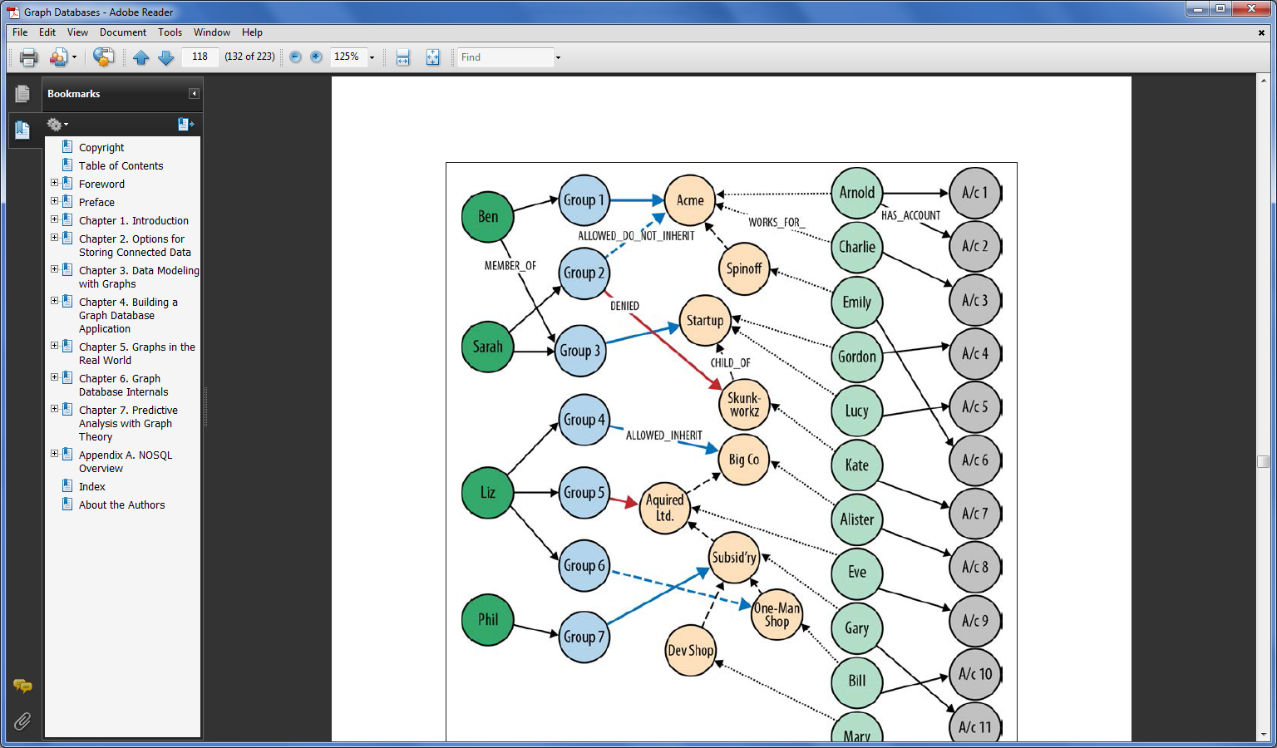
¹“This model comprises two hierarchies. The first hierarchy, admins within each customer organization are assigned to groups; these groups are then granted various permissions against that organization’s structure.”
“Graph Databases”¹
Notes:
Security model with inheritance… Awesome
Had to use NORMA
Implementation was iterative
Passed from team to team

Slide 67
Data Modeling with Graph Databases
Summary
Graph Modeling
Graph Databases
Tail Wind Informatics
Ross McNeely

Slide 68
References
1 “Graph Databases by Ian Robinson, Jim Webber, Emil Eifrem (O’Reilly). Copyright 2013 Neo Technology, Inc., 978-1-449-35626-2.”
2 “Controlling Complexity in Enterprise Architectures: The SIP Methodology by Roger Sessions” (ObjectWatch).
3 http://www.neo4j.org/develop/modeling (Michael Hunger)
4 http://en.wikipedia.org/wiki/R-tree
5 http://blog.bruggen.com/2013/11/clickstreams-are-so-much-nicer-in-neo4j.html
6 http://www.himss.org/News/NewsDetail.aspx?ItemNumber=22312
General References
  https://www.gartner.com/doc/2081316
  http://www.neo4j.org/learn/neo4j
  http://franz.com/agraph/allegrograph/
  http://www.hypergraphdb.org/index
  http://scm.mit.edu/research

