Slide 1
So you want to start a Big Data Project
Big Data 101
Michael Striefel
2/15/2017

Slide 2
Agenda
Big Data
What is it?
How is it being used
Is too much of a good thing (data) a good thing… Sometimes not
Project Prep… it’s all about the DATA
What’s your project all about
Data Sources
Data Privacy & Governance
Technology
Platforms
Development languages
Why are Notebooks so cool
Let’s take Mobile as an example
Data privacy – it’s in everyone’s best interest
Q & A

Slide 3
Big Data, what is it
The definition of Big Data has evolved over time
2011
Datasets whose size is beyond the ability of typical database software tools…
2014
an all-encompassing term for any collection of data sets so large and complex that it becomes difficult to process using on-hand data management tools or traditional data processing applications.
But my favorite is Doug Laney’s 2001 3 V’s
Volume – The scale of the data or deep data
Velocity – Not only the rate of through put, but also the rate of decay
Variety – Different forms of data
Around 2012, the 4th V was introduced
Veracity – The trustworthiness or accuracy of the data

Slide 4
How is it being used
Transportation (delivery/Supply chain)
The combination of sensor, GPS, traffic and driver data
Improved safety & efficiencies and reduced costs
Mass Transit
Mobile & GPS data
Improved routing for bus routes
Public health
Epidemics and disease outbreaks
DNA
Biometrics
Medical devices
Marketing
Understanding the customer
Campaign effectiveness
The list goes on and on

Slide 5
Too much of a good thing (data)
Many Big data projects aren’t successful
Spring 2016 Gartner estimates 60% of projects fail to go beyond pilot or experimentation
But worse… Big data can get your company in the News…
Google’s Flu Project – Are you using the correct predictors?
7 Big Data Blunders – Do you have standards and governance?
7 Big Data Blunders
However, we’re heading in the right direction, but we all need to remember
Big Data makes it very hard to protect identities

Slide 6
Project Prep
What’s your project?
Is it exploratory?
Combine datasets and use Big Data to see what you can find?
It will help assess your data quality
Look for teams with experience in the domains your working with
How will you prove the value?
Or do you have a goal?
Campaign effectiveness
Improved customer interactions
Improves process efficiencies
Thoughts on how to sell the value
You need to think beyond the project, what if this data is compromised?

Slide 7
Data Sources
Some questions to ask
Is this data related to the results we’re looking for?
Extraneous data introduces additional volume and noise into your algorithms
Are all the fields really needed?
Additional information may seem harmless… until it’s integrated with other sources
How many data sources are really needed?
How accurate are the sources
Interpreting social media is very complex, are you ready
What’s the rate of decay
For instance, social media has a high rate of decay
When it’s all said and done, the project is accepting responsibility for securing the data

Slide 8
Data Privacy & Governance
The EU has the most comprehensive set of regulations adopted regarding the use of data
Personal data is ANY information relating to an identified or identifiable natural person
Processing of data must have a lawful basis
Processing of sensitive data such as, political, race, etc.. Is strictly prohibited
Limitations on the se of automated processing, ie. algorithms
Transfer of data outside the EU, can only happen to countries the EU has deemed adequate when it comes to privacy and data protection. The US is not one of these countries.
The US doesn’t have a comprehensive law like the EU Directive, it has a set of laws utilizing federal laws for business sectors for handling sensitive data mostly focused on PII
Financial services sector
The Fair Credit Reporting Act
Medical records
HIPAA
ISP Data
Data breaches at the state level
Data Protection & Privacy 2015

Slide 9
Technology - Platforms
So many choices
Platform
On premise or hosted?
Is the data sensitive?
Is the data sensitive if combined with a minimal number of additional sources?
Admin resources
Length of the project
AWS has Spark or Hadoop platforms
Either will work, for a starter project
Spark is better at streaming and in memory performance is superior
Hadoop is better at distributed workloads
If your project gets big enough, you’ll probably want both

Slide 10
Technology – Development tools
R or Python… depends on what your doing
R introduced in 1995
More geared toward statistics, data science community
Syntax is harder
Better visualizations
Large repository of curated R packages
Python introduced in 1991
More of a general purpose language with an emphasis on data analysis and statistics
Easier learning curve
Large set of available libraries, however developed by various organizations
Complete programing language

Slide 11
Technology – Why are Notebooks so cool?
Integrate text and programming languages
Can be used with a variety of programming languages
Demo Jupyter
FunF – used to collect mobile data from an Andriod device

Slide 12
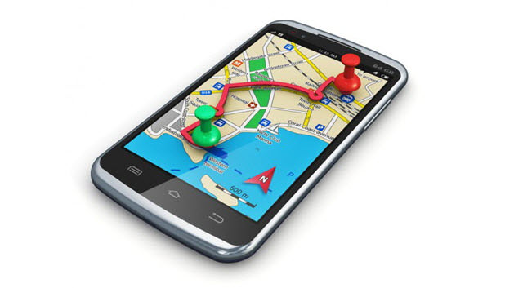
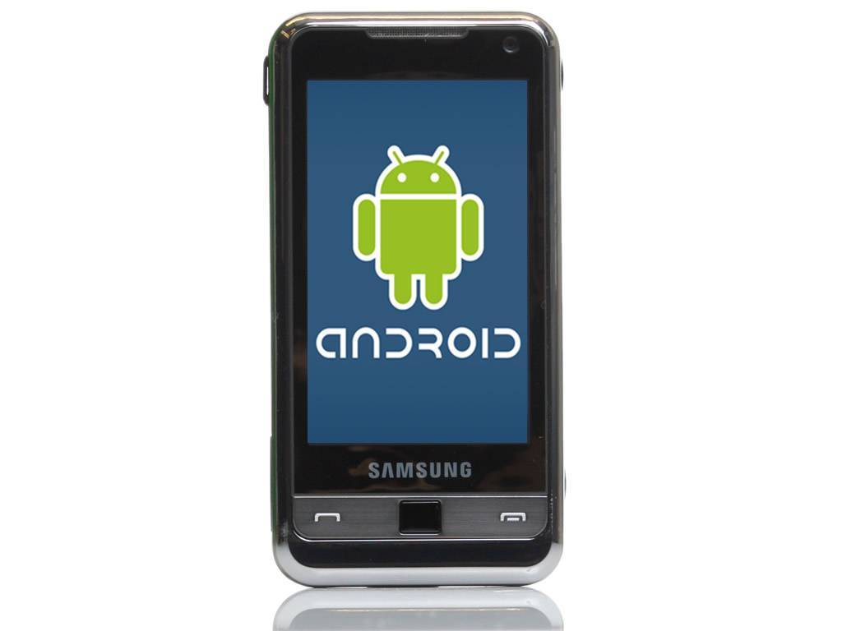
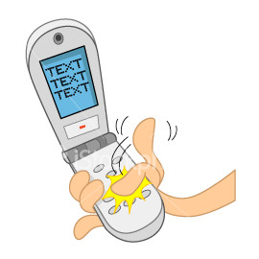
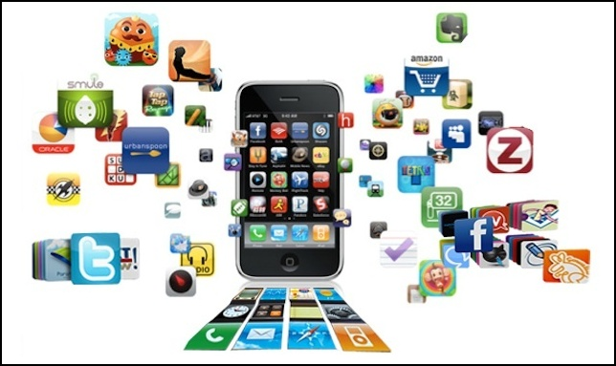
Mobile Data
What kind of data can you get from a phone?

Slide 13
So Where have you been
Go ahead, turn off your GPS
Using wireless access points to determine locations
Using Python utils library

Slide 14
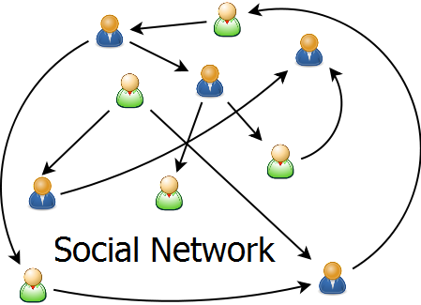
Network Analysis
What influences your purchasing decisions?

Slide 15
Network Examples
Using Python networkx
Peer analysis
Network clustering

Slide 16
So Who Have you Called?
Mobile data analysis using Bandicoot
Accepts a standardized format
Has a wide variety of pre built algorithms for mobile data

Slide 17
The spread of Contagions
Effective distance and shortest paths in global mobility

Slide 18
Data Privacy
William Weld Case
1990 Massachusetts Group Insurance Commission (GIC) released hospital data for the purpose of improving healthcare and controlling costs. William Weld, the governor of Massachusetts, assured the public that GIC had protected patient privacy by deleting identifiers (Sweeney 2002)
Sweeney (2002) later demonstrated that 87% of Americans can be uniquely identified by their zip code, gender and birth date

Slide 19
When it comes to mobile data… it’s worse
1.5 million cell users
Over a course of a year
Any guesses at how many visits (location and timestamp) to identify 95% of the users?
de Montjoye Yves-Alexandre, Laura Radaelli, Vivek Kumar Singh, Alex “Sandy” Pentland. 2015. “Unique in the Shopping Mall: On the Re-identifiability of Credit Card Metadata.” Science 347:536- 539. doi:10.1126/science.1256297.
4

Slide 20
Options for protecting data
Data Anonymization is no longer a singular option for protecting identities when it comes to big data
Unicity is a statistical tool used to measure how much “outside” information is needed for identify an “anonymous” individual within a dataset.
Python has a library for this, expensive computational costs, use sample sets
Coarsening the data
Remove elements that aren’t needed
Hashed keys
Encryption

